Slide 1
OMNITENANT UI/UX DESIGN
Role-Based Interfaces for Autonomous Commerce
ALL 12 VISUAL ASSETS IN docs/images/
• 01 Two Separate Portals: Admin Backoffice (/admin) for staff and Storefront (/{tenant-slug}) for customers
• 02 Four User Roles: Tenant Owner, Warehouse Operator, B2B Wholesale Buyer, and B2C Shopper
• 03 Role-Based Menus: Sidebar automatically hides pricing and finance menus from warehouse staff
• 04 Human-in-the-Loop AI: AI prepares draft orders, POs, and discounts; humans click once to approve
• 05 Zero-Overselling UX: Live channel stock pools and a 15-minute checkout countdown timer
00 — Architecture Diagrams (2 Files)
mindmap.png & sitemap.png
01 — Shared Sign-In (1 Screen)
chung/01-login-role-switcher.png
02 — Tenant Owner (5 Screens)
Dashboard, Agent 1, Agent 2, Agent 3, B2B Credit
03 — Warehouse Operator (2 Screens)
Omnichannel Stock Allocation & Conflict Queue
04 — Customer Storefront (2 Screens)
B2B Bulk CSV Upload & 15m Hold Checkout

Slide 2
TABLE OF CONTENTS
Five User Journeys Across All Screens
WHO USES WHICH PORTAL?
• 01 System Mindmap & Sitemap: Overview of core modules and customer storefront page hierarchy
• 02 Universal Sign-In: Single login page with 1-click demo role switching
• 03 Tenant Owner Screens: Executive dashboard, 3 AI agent studios, and B2B credit approval
• 04 Warehouse Operator Screens: Channel stock allocation, safety buffer, and WMS conflict resolution
• 05 Storefront Screens: Self-service B2B CSV upload and 15-minute locked checkout
PORTAL 1 — Admin & WMS Backoffice (/admin)
Used by Tenant Owner (full menu) and Warehouse Operator (stock menu only).
PORTAL 2 — Customer Storefront (/{tenant-slug})
Used by B2B Wholesale Buyers and B2C Shoppers. Top e-commerce navbar.
DESIGN — Consistent Visual Language
Inter typography, high-contrast status pills, and 1-click action buttons.
FLOW — Connected End-to-End
Every dashboard alert links directly to its corresponding action screen.

Slide 3
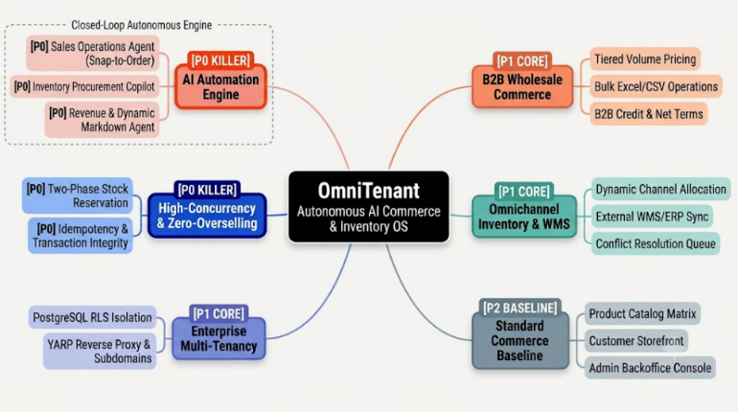
01. PRODUCT MINDMAP
Core Modules & Feature Priority
• 01 Purpose: Maps out all 6 modules of the OmniTenant platform by priority
• 02 P0 AI Engine: Agent 1 (Snap-to-Order), Agent 2 (Runway Copilot), and Agent 3 (Markdown)
• 03 P0 Stock Locking: Two-Phase reservation preventing flash-sale overselling
• 04 P1 & P2 Foundation: B2B wholesale tiers, WMS sync, and PostgreSQL RLS tenant isolation
System Capability Mindmap

Slide 4
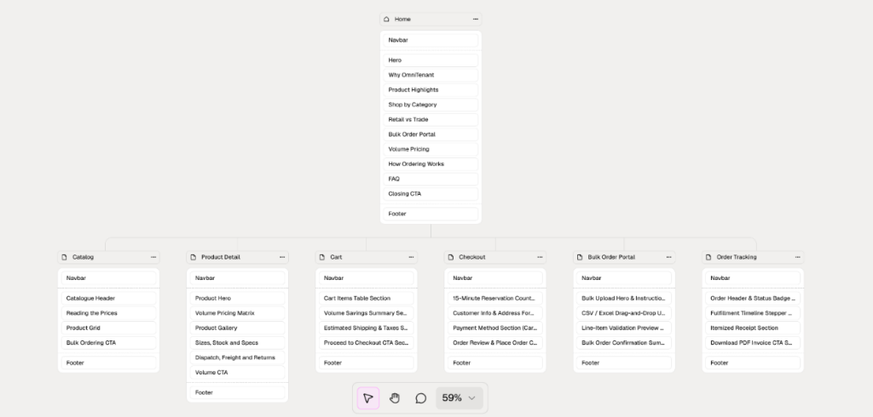
01. STOREFRONT SITEMAP
Customer & B2B Storefront Page Flow
• 01 Target Users: B2B Wholesale Buyers and B2C Online Shoppers
• 02 Browse & Product: View catalog items, live stock counts, and B2B volume discounts
• 03 Cart vs Checkout: Add items freely in Cart; 15-minute stock lock starts only at Checkout
• 04 Bulk & Tracking: Upload 2,000-row CSV wholesale orders and track real-time shipments
Storefront Navigation Hierarchy

Slide 5
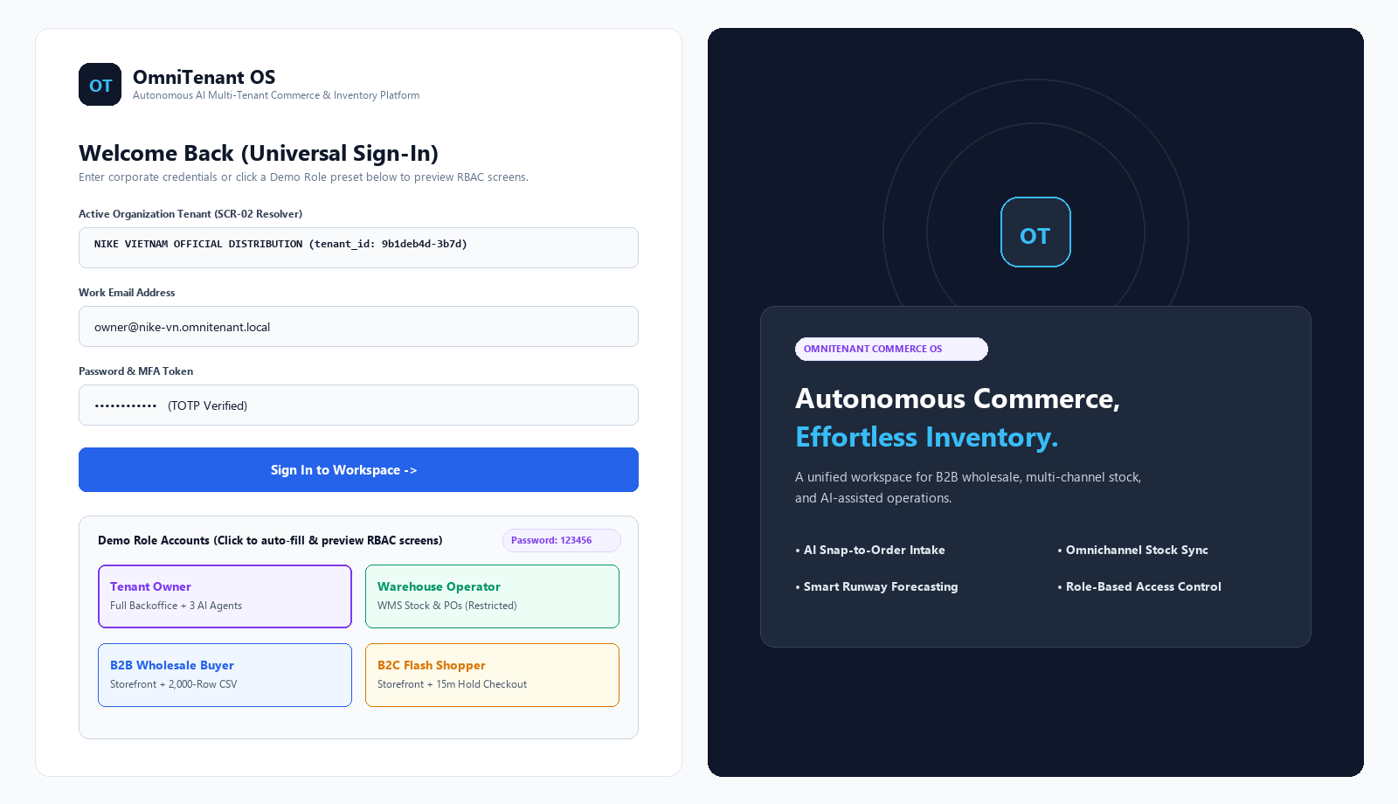
02. UNIVERSAL SIGN-IN
Multi-Tenant Login & Demo Role Switcher
• 01 Target Users: All 4 user roles (Owner, Warehouse Staff, B2B Buyer, B2C Shopper)
• 02 Purpose: Authenticate into the active tenant workspace (NIKE VIETNAM)
• 03 Where to Click: Click any of the 4 Demo Role cards at the bottom-left to auto-fill credentials
• 04 Final Action: Click [Sign In to Workspace ->] to open that role's dedicated portal
Login & RBAC Switcher

Slide 6
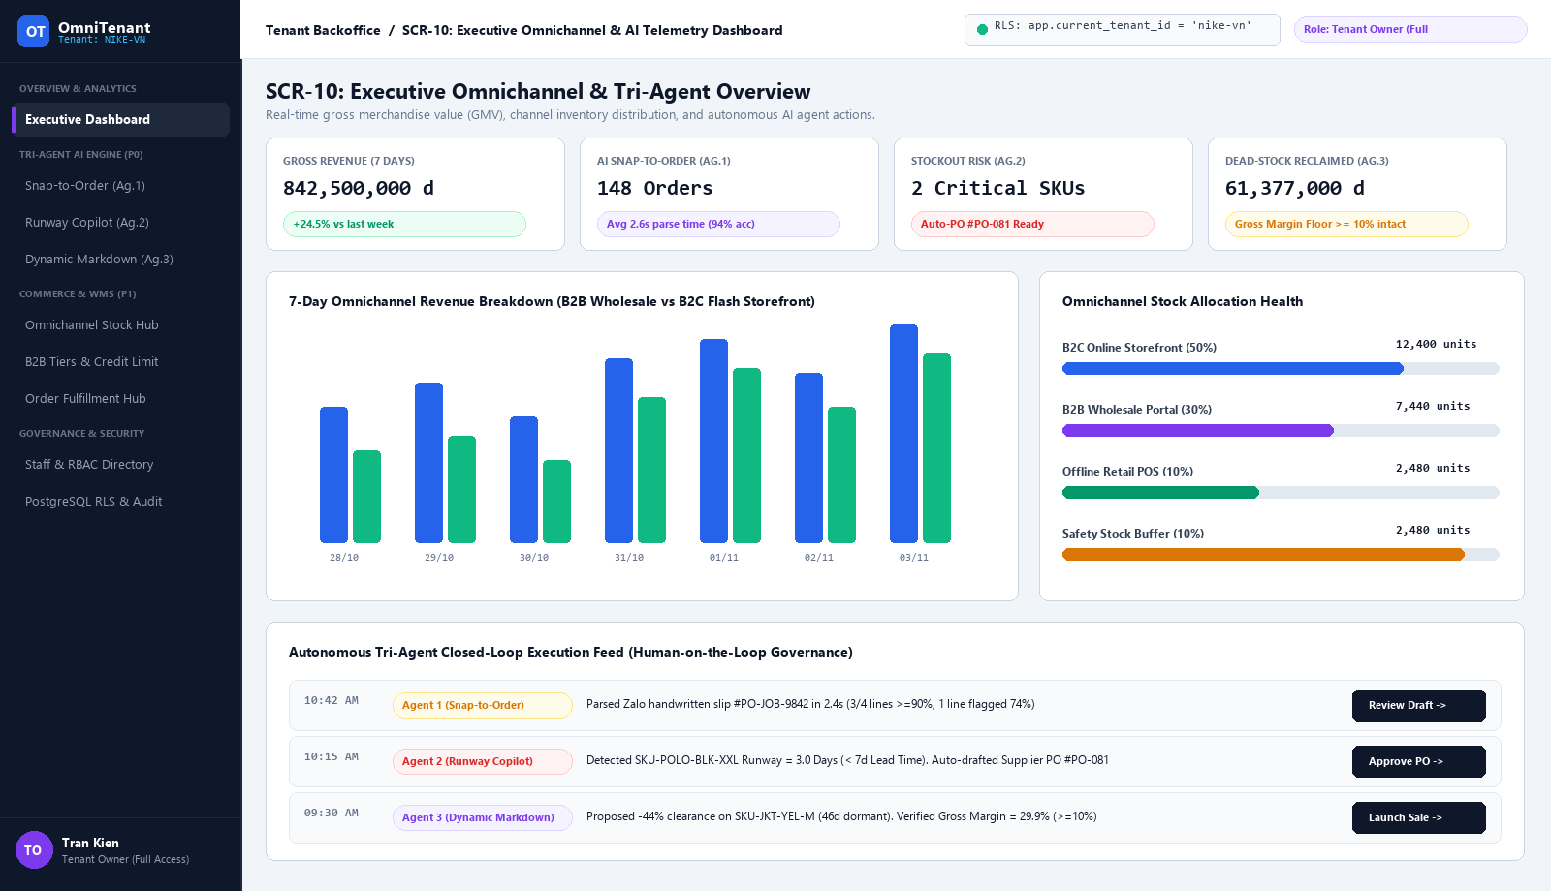
03. TENANT OWNER
Executive Dashboard & AI Action Feed
• 01 Target User: Tenant Owner (Full access to all 8 sidebar menus)
• 02 Purpose: Monitor 7-day B2B vs B2C revenue, channel stock, and pending AI tasks
• 03 Where to Look: Check the top KPI cards, revenue chart, and 4 channel stock bars
• 04 Where to Click: Click [Review Draft], [Approve PO], or [Launch Sale] in the bottom AI feed
Executive Overview (SCR-10)

Slide 7
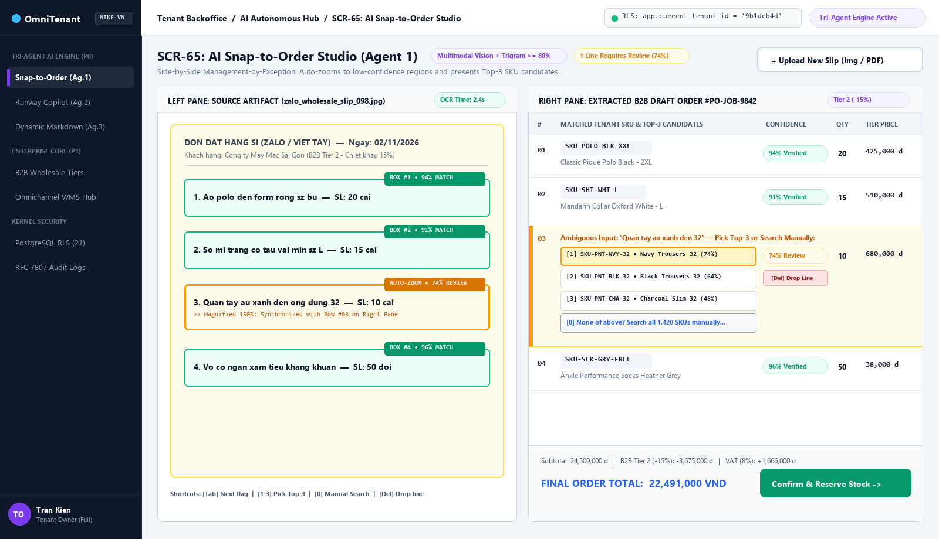
03. TENANT OWNER
Agent 1: AI Snap-to-Order Studio
• 01 Target Users: Tenant Owner & Sales Operator
• 02 Purpose: Turn handwritten Zalo order photos into B2B orders in 3 seconds
• 03 Where to Click: Click yellow Row #03 (74% match) to pick Top-3 SKU, or press [0] to search
• 04 Final Action: Click [Confirm & Reserve Stock ->] at the bottom-right to lock stock
Snap-to-Order Studio (SCR-65)

Slide 8
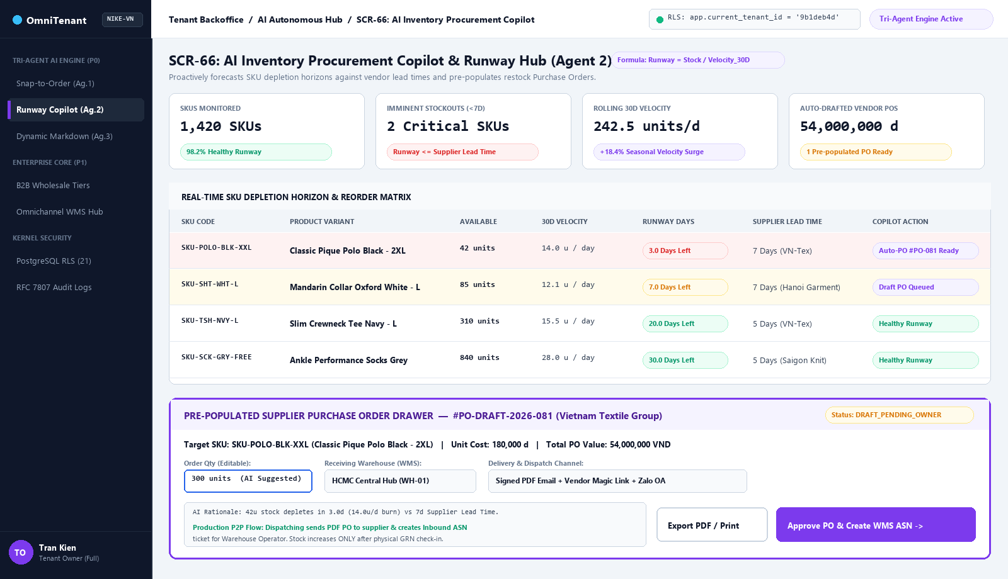
03. TENANT OWNER
Agent 2: AI Inventory Procurement Copilot
• 01 Target Users: Tenant Owner & Warehouse Manager
• 02 Purpose: Spot SKUs running out of stock (< 7 days) and send restock POs to suppliers
• 03 Where to Edit: Adjust [Order Qty (300u)] and [Receiving Warehouse] in the bottom drawer
• 04 Final Action: Click [Approve PO & Create WMS ASN ->] to email the supplier and notify WMS
Procurement Copilot (SCR-66)

Slide 9
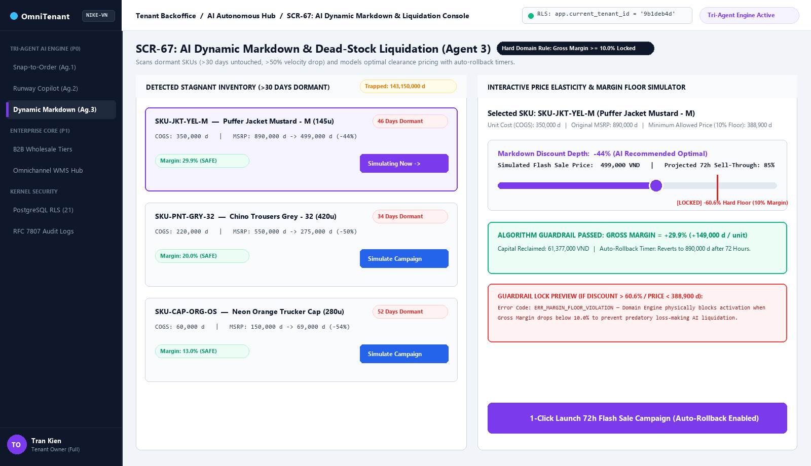
03. TENANT OWNER
Agent 3: AI Dead-Stock Markdown Console
• 01 Target User: Tenant Owner Only (Hidden from Warehouse Operators)
• 02 Purpose: Clear out slow-moving items (> 30 days) without losing profit margin
• 03 Where to Click: Select an item on the left, then drag the purple discount slider on the right
• 04 Final Action: Click [1-Click Launch 72h Flash Sale] (locked if margin drops below 10%)
Dynamic Markdown Console (SCR-67)

Slide 10
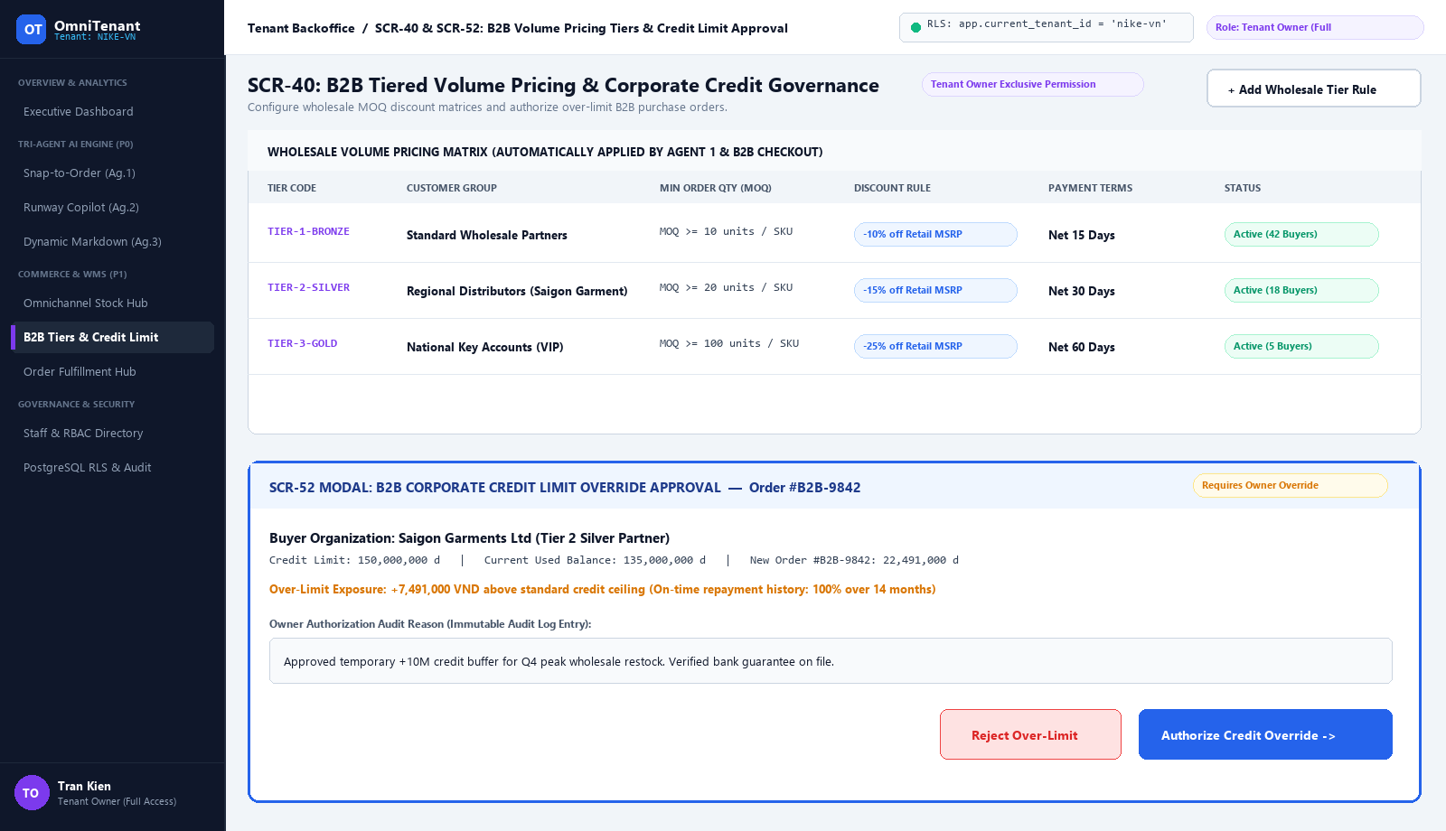
03. TENANT OWNER
B2B Wholesale Tiers & Credit Approval
• 01 Target User: Tenant Owner Only (Exclusive financial permission)
• 02 Purpose: Set B2B bulk discount rules and approve orders that exceed credit limits
• 03 Top Table: Click [+ Add Wholesale Tier Rule] to configure Bronze, Silver, and Gold MOQs
• 04 Bottom Modal: Enter an audit reason and click [Authorize Credit Override ->] to release order
B2B Pricing & Credit (SCR-40 & SCR-52)

Slide 11
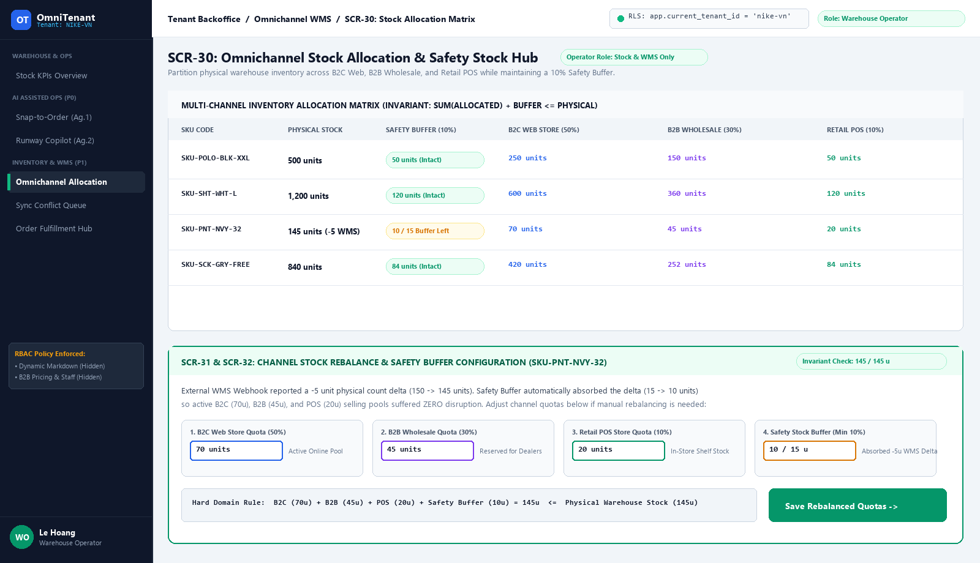
04. WAREHOUSE OPERATOR
Omnichannel Stock Allocation & Rebalance
• 01 Target User: Warehouse Operator (Pricing and credit menus are hidden by RBAC)
• 02 Purpose: Split physical stock across B2C (50%), B2B (30%), POS (10%), and Buffer (10%)
• 03 Where to Edit: Type new channel quotas into the 4 input boxes inside the bottom drawer
• 04 Final Action: Click [Save Rebalanced Quotas ->] to shift stock between sales channels
Stock Allocation Hub (SCR-30)

Slide 12
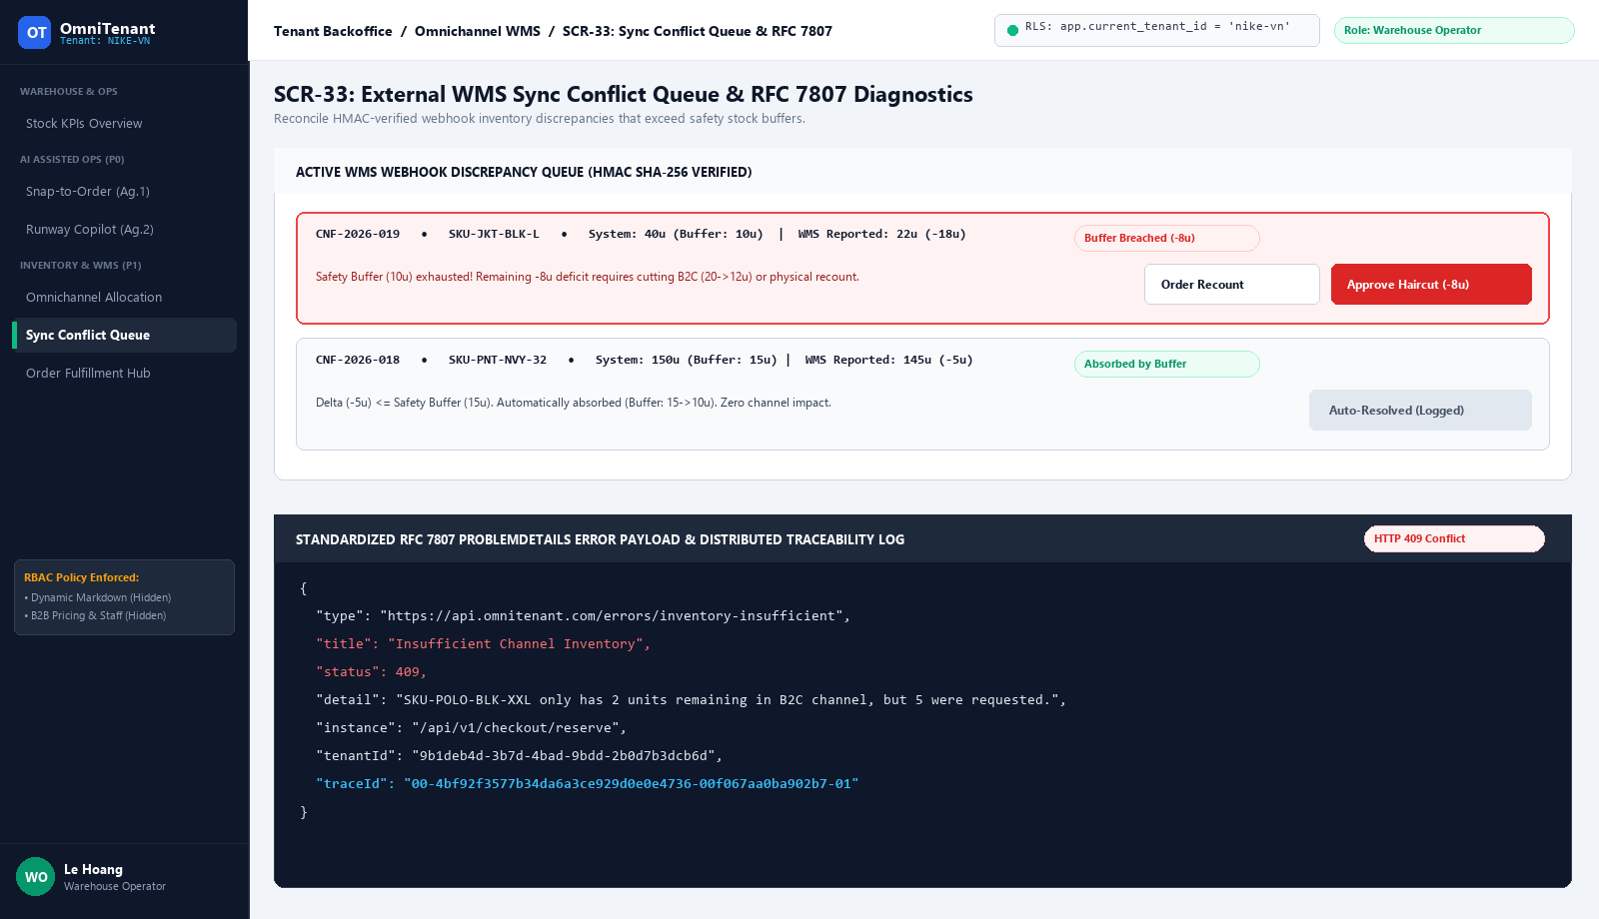
04. WAREHOUSE OPERATOR
WMS Sync Conflict Queue & Error Logs
• 01 Target User: Warehouse Operator
• 02 Purpose: Resolve physical stock shortages when warehouse counts drop below the buffer
• 03 Where to Click: On red alert CNF-2026-019 (-18u shortage), review the -8u buffer breach
• 04 Final Action: Click [Order Recount] to re-verify shelves or [Approve Haircut (-8u)] to cut B2C stock
Conflict Queue & RFC 7807 (SCR-33)

Slide 13
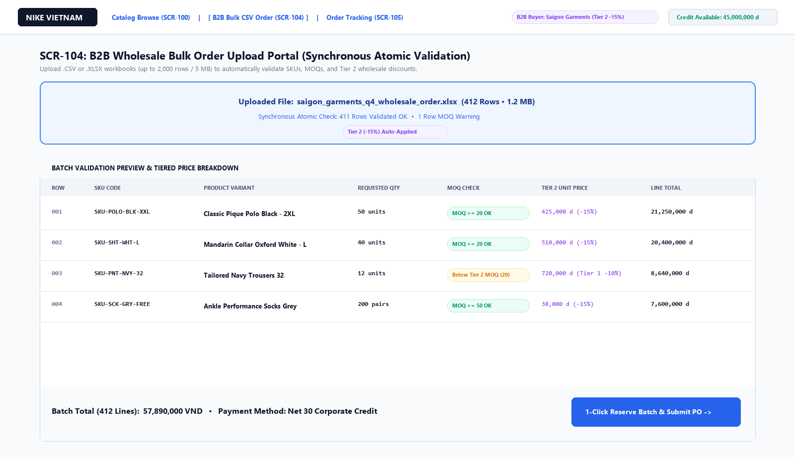
05. STOREFRONT WEB APP
B2B Wholesale Bulk CSV Upload Portal
• 01 Target User: B2B Wholesale Buyer / Dealer (Using the separate Customer Storefront)
• 02 Purpose: Place large wholesale orders (up to 2,000 rows) by uploading an Excel/CSV file
• 03 Where to Click: Drop the .XLSX file into the blue upload zone to check SKUs, MOQs, and Tier 2 prices
• 04 Final Action: Click [1-Click Reserve Batch & Submit PO ->] to lock all 412 lines at once
B2B Bulk Order Portal (SCR-104)

Slide 14
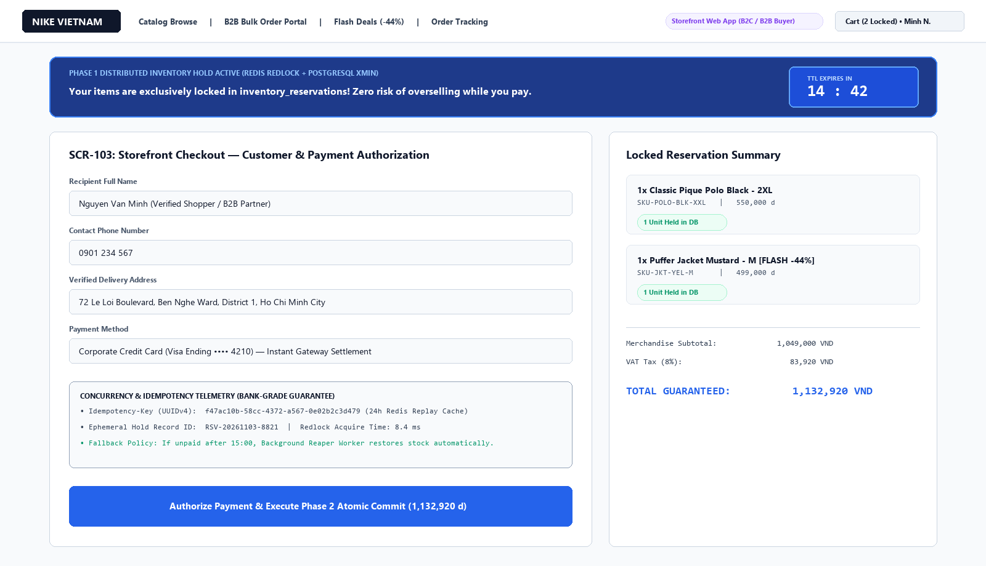
05. STOREFRONT WEB APP
High-Concurrency 15-Minute Hold Checkout
• 01 Target Users: B2C Flash-Sale Shopper & B2B Buyer paying by credit card
• 02 Purpose: Lock cart items for 15 minutes during checkout so nobody steals them while paying
• 03 Where to Fill: Enter delivery details and payment card while the 14:42 blue timer counts down
• 04 Final Action: Click [Authorize Payment & Execute Phase 2 Atomic Commit] to complete purchase
15-Minute Hold Checkout (SCR-103)

